Slide 1
REALINE HOSPITALITY GROUP
Granary Live
Winter Activation Strategy
Transforming a Seasonal Concert Venue into a Year-Round Revenue Asset
Declan Murray | Revenue & Operations Strategy | Salt Lake City, UT | 2024–2025
Notes:
Cover slide. Introduce yourself and the project context. Emphasize that this was an internally-generated initiative—you identified the opportunity and drove it from concept to feasibility recommendation.

Slide 2
Executive Summary
The core findings and recommendation at a glance
4 Months
$123K
$30,950
80+
Annual Revenue Gap
Rent-to-Buy Rink Cost
Projected 2-Week Revenue
Skaters Per Session
Venue dark Nov–Mar
Iron Sleek Option 4
Opening period, Dec 1–14
Based on 44×80 ft rink
Granary Live loses ~4 months of revenue potential each winter. This study evaluates converting the venue into a refrigerated outdoor ice rink with curling lanes and a Rail Jam launch event. Based on vendor quotes from Iron Sleek Outdoor Rink Systems, competitive benchmarking, and a detailed revenue model, the project is financially viable with a path to profitability in Year 1.
Recommendation: Proceed with Rink Set Option 4 (44×80 ft + 2 curling lanes) for Winter 2025–26 targeting December 1 launch.
Notes:
Walk through each stat briefly. The recommendation banner is your anchor—return to it at the end. Emphasize that the $30,950 two-week projection is conservative and built from unit economics, not assumed.

Slide 3
Project Overview
Scope, timeline, and my role in the initiative
My Role & Responsibilities
Employer
Realine Hospitality Group / LNE Presents
Opportunity identification & framing
Market research — SLC winter entertainment
Competitive analysis of existing ice rinks
Vendor outreach & quote comparison
Revenue modeling & financial projections
Rail Jam event concept development
Sponsor outreach — 5 brands engaged
Leadership presentation & recommendation
Venue
Granary Live — Salt Lake City, UT
Project Period
Fall 2024 — Spring 2025
Deliverables Produced
Vendor RFQ and quote analysis
Preliminary financial model
Rail Jam event spec & vendor brief
Sponsor prospect list
Leadership recommendation deck
Notes:
This slide establishes what you owned. Emphasize breadth: vendor outreach, financial modeling, event strategy, and sponsor development all owned by you as an early-career contributor.

Slide 4
BUSINESS PROBLEM
The Seasonal Revenue Gap
Fixed Costs Continue
Lease, insurance, and maintenance obligations persist through winter regardless of revenue.
Asset Sits Idle
Existing infrastructure—shipping containers, lighting, turf, sound—generates zero return for 4+ months.
Competitor Gap
Salt Lake City has limited premium outdoor winter entertainment. Millcreek & Gallivan charge $14–16 with no differentiation.
* Revenue index is illustrative. Replace with actuals when available.
Notes:
The bar chart shows winter dormancy visually. The three pain points translate that into business impact: fixed costs, idle assets, and a market gap. Each is a strategic lever—not just a problem.

Slide 5
Opportunity Identification
Reframing the asset from a concert venue to a year-round entertainment platform
"How can we transform an underutilized seasonal venue into a profitable winter destination while leveraging existing infrastructure and minimizing additional capital investment?"
1
Existing Infrastructure
2
Captive Brand Audience
Shipping containers, turf, lighting, sound systems, and bar operations are already in place—reducing activation cost significantly.
Granary Live's existing fan base and marketing channels provide a ready pipeline for winter programming launch.
3
Market Whitespace
4
Scalable Model
No premium outdoor skating destination in the Granary District. Nearest competitors are downtown and lack the venue character.
Iron Sleek rink is modular and expandable. Year 1 proves the model; Years 2–3 can expand capacity and programming.
Notes:
Frame this as asset management thinking, not just event planning. You weren't proposing an ice rink—you were identifying how to put an existing asset to productive use year-round.

Slide 6
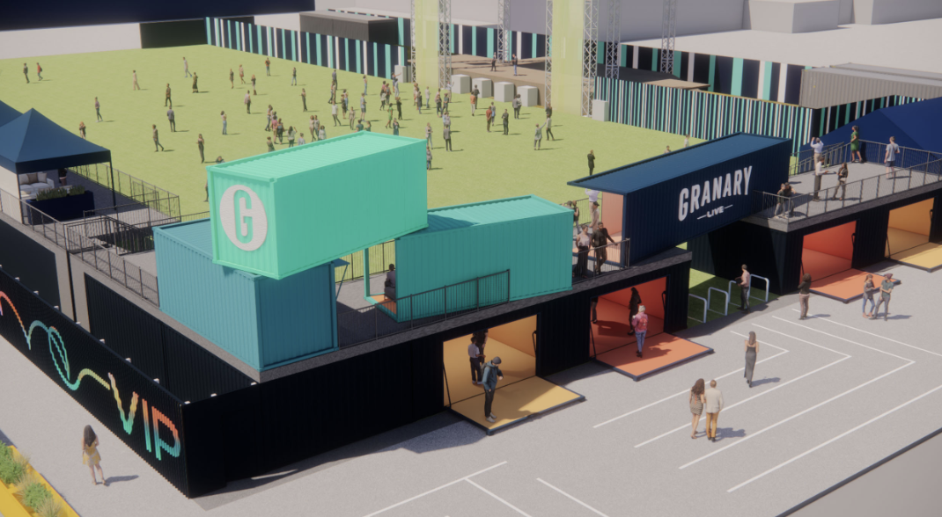
Why Granary Live?
The venue's existing attributes make it uniquely suited for this activation
CAPITAL EFFICIENCY
PREMIUM EXPERIENCE
SPACE FIT
Shipping Container Infrastructure
Rooftop Deck & Bar
Open Turf Field
Existing 2-story container structure provides natural scaffolding for the Rail Jam double-tier course, eliminating major build costs.
VIP rooftop deck with string lighting creates instant premium winter atmosphere at no added cost. Bar operations already licensed.
Large flat grass area (~300 ft long) accommodates a 44×80 ft rink plus curling lanes with room for spectators and vendor footprint.
MARKETING LEVERAGE
LOCATION
LOW RISK
Brand & Audience
Granary District Location
Modular & Reversible
Established social following and event brand awareness in SLC entertainment market. Granary Live = experiential destination.
Emerging entertainment hub with proximity to downtown, highway access, and adjacent parking. Foot traffic opportunity.
Refrigerated rink system rolls up and stores at season end. No permanent alteration to venue or disruption to summer concert calendar.
GRANARY LIVE — VENUE RENDER
Notes:
Six distinct competitive advantages—each one reduces risk and increases feasibility. Stress the capital efficiency angle: other venues would need to build infrastructure from scratch.

Slide 7
Salt Lake City Market Analysis
A growing metro with strong winter recreation culture and underserved entertainment demand
1.2M+
Salt Lake Metro Population
Fastest-growing metro in the US (2020s)
#1
State for Outdoor Recreation
Utah leads US in outdoor rec spending
$4.4B
Utah Ski Industry Revenue
Annual economic impact, Utah Ski Areas Assoc.
6–8
Winter Months of Opportunity
Nov–Apr; avg low temp 28°F in Dec/Jan
* Market stats sourced from US Census Bureau, Utah Office of Tourism, Utah Ski Areas Association. Demand index is illustrative — replace with primary research.
Notes:
SLC is not a saturated market for outdoor winter entertainment—it's a market with strong demonstrated demand for winter recreation but limited non-ski/snowboard options. That's the gap.

Slide 8
DEMAND ANALYSIS
Winter Recreation Demand in SLC
Ice Skating
Ski Culture
Millcreek Commons and Gallivan Center operate at capacity on weekends, charging $14–16/person with no premium experience. Demand clearly exceeds current supply.
Utah's "Greatest Snow on Earth" brand drives outsized winter recreation engagement. Skiers and snowboarders represent a natural audience for the Rail Jam concept.
Winter Events
F&B Potential
Sundance Film Festival (Jan), Utah Jazz season, and holiday events demonstrate strong consumer willingness to be outside in winter for the right experience.
Iron Sleek's own case studies show outdoor rinks drive significant food & beverage uplift. Granary Live's existing bar operations can capture this directly.
Key Insight: SLC winter demand exists and is underserved. The opportunity is to capture a premium slice of it at an already-established entertainment destination.
Notes:
Ground the demand story in facts: existing rinks at capacity, ski culture penetration, proven F&B uplift from comparable venues. The competitor data (Millcreek/Gallivan at $14-16) is real—you gathered it.

Slide 9
Competitive Landscape
How Granary Live Winter compares to existing Salt Lake City ice rinks
Venue | Location | Admission | Refrigerated | F&B On-Site | Events / Extras | Premium Feel
Millcreek Commons | Millcreek, SLC | $14–16/person | No | Limited | Basic public skating | Low
Gallivan Center | Downtown SLC | $14–16/person | No | Nearby F&B | Seasonal holiday events | Moderate
Smith's Ballpark (winter) | SLC CBD | $12–18/person | Yes (indoor) | Full bar | Hockey leagues | Moderate
Granary Live Winter ★ | Granary Dist. | $14–20/person | YES (Iron Sleek) | Full bar + rooftop | Rail Jam, curling, events | HIGH
Competitive Differentiation:
Granary Live is the only competitor offering refrigerated ice, on-site full bar, rooftop views, and premium events (Rail Jam, curling) under one roof. At comparable pricing, the value proposition is significantly stronger.
Notes:
This table came from direct research—you called Millcreek and Gallivan to check prices. The differentiation story is clear: same price point, dramatically better experience.

Slide 10
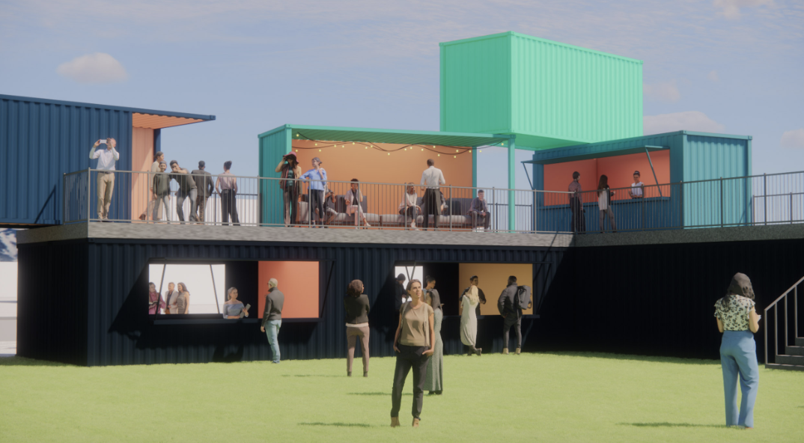
Ice Rink Concept
Recommended configuration: Iron Sleek Outdoor Rink Systems — Option 4
Vendor:
Iron Sleek Outdoor Rink Systems
Admission Pricing
System:
Portable Refrigerated — Plug & Skate
Period | Adult | Kids | BYOS
Off-Peak Weekday | $14 | $10 | $10
Off-Peak Weekend | $18 | $10 | $10
Peak Weekday | $18 | $12 | $10
Peak Weekend | $20 | $13 | $12
Configuration:
44 ft × 80 ft rink + 2 curling lanes
Total Ice Area:
3,520 sq ft rink + 500 sq ft curling
Skater Capacity:
~80 skaters (40 sq ft/skater)
Chillers Needed:
4 units (single-phase power)
Season:
Dec 1 – March 31 (late Nov to early Apr)
Temp Range:
Solid ice up to 50°F
Setup Time:
Under 2 weeks (ready by Dec 1)
Modularity:
Expandable in future seasons
GRANARY LIVE — ROOFTOP DECK & BAR
Notes:
This is the core product. Highlight that Option 4 was the vendor's own recommendation—a 44x80 rink supports 80 skaters which is appropriate for the venue footprint. BYOS = Bring Your Own Skates.

Slide 11
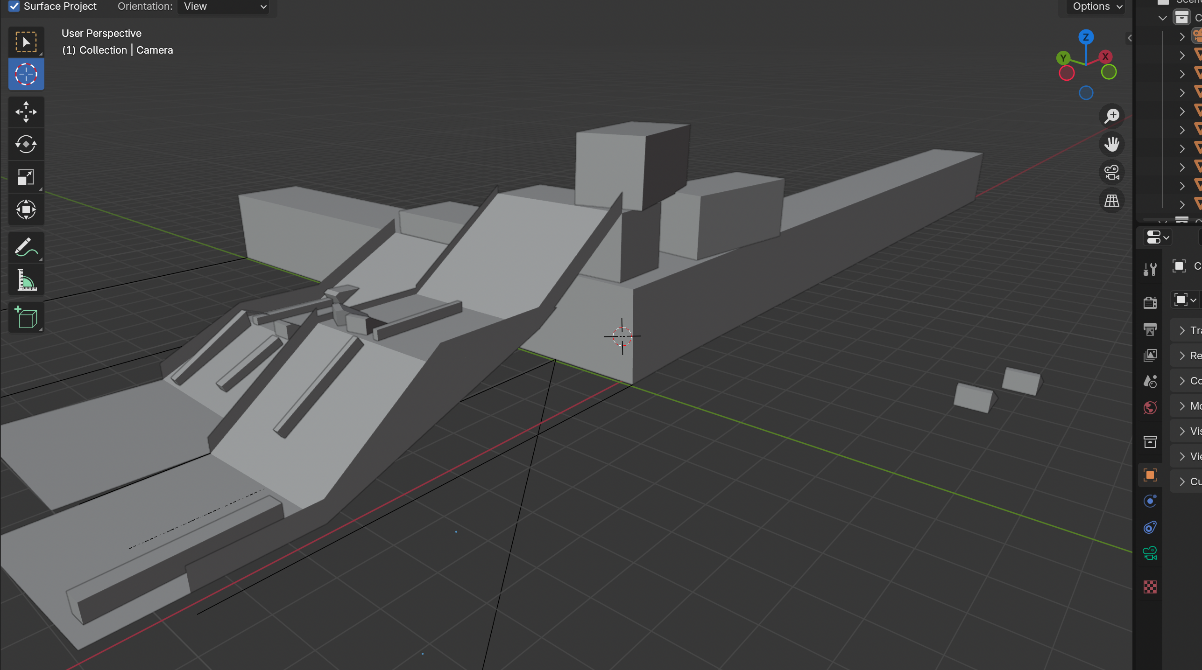
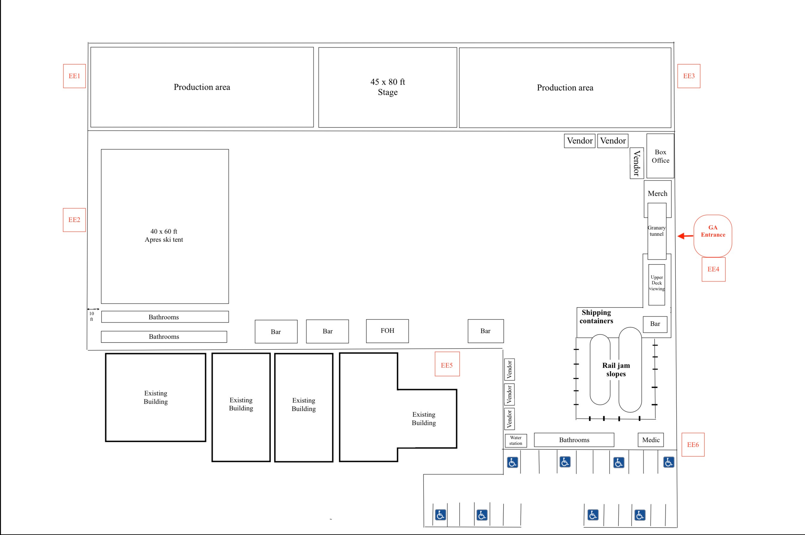
LAUNCH EVENT
ShredFest — Rail Jam Launch Event
Event Specs
Media & PR Hook
A pro-am rail jam is inherently photogenic and shareable—built-in social media content generation.
Date:
December 14, 2024
Hours:
12:00 PM – 10:00 PM
Opening Day Draw
Location:
Granary Live, SLC
Creates urgency for first-time visitors and drives attendance for the rink's December 1 soft open through December 14 launch weekend.
Vendor:
Snow Bro / Headline Inc.
Length:
105 ft (longest dimension)
Sponsorship Platform
Structure:
Double-tier off shipping containers
Brands like Demon United, Salomon, Monster, and EVO already engaged. Sponsorship revenue offsets event production cost.
Community Positioning
Beginner + Advanced levels make it inclusive—families, park rats, and pros all participate, broadening demographic reach.
3D COURSE MODEL
VENUE SITE MAP
Sponsors Engaged: Demon United · EVO · Park City Ski & SB · Salomon · Monster Energy
Notes:
The Rail Jam was your concept—make that clear. It solved a marketing problem (how do you launch an ice rink?) with a distinctly Granary Live answer. The 3D models in the images show the planned double-tier structure.

Slide 12
Vendor & Supplier Research
Outreach across multiple categories; final selections based on fit, capability, and cost
Ice Rink — Iron Sleek System Comparison
Option | Rink Size | Curling Lanes | Skaters | Purchase Price
Option 1 | 40 × 80 ft | 2 lanes | 70–80 | $189,950
Option 2 | 44 × 80 ft | 4 lanes | 75–80 | $239,890
Option 3 | 48 × 100 ft | 4 lanes | 90–100 | $299,500
★ Option 4 (Rec.) | 44 × 80 ft | 2 lanes | ~80 | $189,950
Other Vendor Research
SNOW & RAIL JAM
Snow Bro / Headline Inc.
Rails, ramps, scaffolding, snow, event mgmt, pro athlete recruitment
SKATE RENTAL
Riedell (wholesale bundle)
Rent-to-Buy Structure (Recommended)
157-pair bundle with full size range. $9,500 — vs. $8,000 wholesale alt.
Total rental price: 65% of purchase cost ≈ $123,000
Upfront payment: 20% of rental ≈ $24,500 + shipping / travel
Remaining balance spread across season
End of season: Iron Sleek collects & stores until next year
Optional future buyout to own outright
ICE RESURFACING
Used Zamboni (Marketplace)
Sourced in Victor, ID. $8,500 — adequate for public session resurfacing.
Notes:
You personally initiated all vendor conversations—cold outreach to Iron Sleek, Snow Bro, and wholesale skate suppliers. That vendor development process is as important to show as the final numbers.

Slide 13
Operational Requirements
Key logistics, staffing, and infrastructure needs for a functional winter activation
Setup & Installation
Daily Operations
Iron Sleek team: 6–8 days build in Chicago, 2 days SLC install
Target ready date: December 1
Rink boards, liner, chillers, piping (all-inclusive in system)
Flat stable surface required — Granary turf qualifies
Single-phase electrical hookup
Ice maintenance: Zamboni resurface between sessions (2–3x daily)
Skate rental station: 157-pair fleet, lace-up benches
Session timing: recommend 90-min public sessions
Admission desk + wristband system
Safety monitors on-ice (2–3 per session)
Staffing Requirements
End-of-Season Teardown
Rink Manager (seasonal FT)
Ice monitors / guards (2–4 per shift)
Skate rental attendants (2 per shift)
Bar staff (leverages existing team)
Rail Jam day: additional event staff + security
Iron Sleek collects & stores all rink components
Rink offline by April 1 — zero disruption to spring concert season
Zamboni stored on-site (compact footprint)
Skates stored in existing venue storage
Notes:
The operational picture matters for credibility—you're not just proposing a concept, you've thought through the day-to-day. Emphasize that the Iron Sleek team handles installation and teardown, reducing the operational learning curve.

Slide 14
Revenue Model
Unit economics and pricing strategy driving the financial projection
Tiered Pricing Structure
Period | Adult | Child (U12) | BYOS Discount
Off-Peak Weekday (Mon–Thu) | $14 | $10 | $10
Off-Peak Weekend (Fri–Sun) | $18 | $10 | $10
Peak Weekday (Dec 14–31) | $18 | $12 | $10
Peak Weekend (Dec 14–31) | $20 | $13 | $12
Key Assumptions
75% adult / 25% child mix (off-peak); 70/30 peak
Weekday avg: 100 skaters/day; Weekend avg: 175/day
Peak weekends (Dec 14–31): 200 skaters/day
Rink capacity: ~80 per session × 3–4 sessions/day
Competitor pricing benchmark: $14–16 (Millcreek, Gallivan)
F&B uplift and skate rental revenue modeled separately
* F&B uplift is a conservative estimate — replace with actuals. All figures are projections.
Notes:
Walk through the pricing tiers first—explain why tiered pricing (time/demand-based) captures more value than a flat rate. Then note that the $291,000 total revenue figure across streams makes the $24,500 upfront cost look very conservative.

Slide 15
Financial Projection
Year 1 economics built from unit-level assumptions; 2-week opening period validated
2-Week Opening Period Projection (Dec 1–14)
Period | Sessions | Avg Skaters/Day | Daily Revenue | Period Total
Off-Peak Weekdays (8 days) | 8 | 100 | $1,300 | $10,400
Off-Peak Weekends (3 days) | 3 | 183 avg | $3,200 | $9,600
Peak Weekend (Dec 12–14) | 3 | 200 | $3,650 | $10,950
TOTAL 2-WEEK | 14 | — | — | $30,950
Year 1 Economics Summary
Upfront Capital (rink + skates + Zamboni)
~$42,500
Estimated Full-Season Admission Revenue
~$210,000*
Total Revenue (all streams)
~$291,000*
Rent-to-Buy Rink Cost (Year 1)
~$123,000
Estimated Net Margin (Year 1)
~$168,000*
* Full-season projections are estimates. The $30,950 two-week figure is built from unit-level assumptions.
Notes:
Lead with the $30,950 two-week opening figure—that's the most defensible number, built from actual unit economics. The full-season estimate scales that forward conservatively. Emphasize the $42,500 upfront is low relative to the revenue opportunity.

Slide 16
Risks & Challenges
Identified risks and corresponding mitigation strategies
Risk | Impact | Likelihood | Mitigation
Warm Weather / Ice Quality | Medium | Low | Iron Sleek refrigerated system maintains ice up to 50°F. SLC December avg high is 38°F—well within range.
Low Year 1 Attendance | High | Medium | Rail Jam launch event drives opening day buzz. Pricing parity with competitors reduces trial barrier.
Capital Constraint | High | Low | Rent-to-buy structure limits upfront to ~$42,500. Sponsorship revenue can offset event launch costs.
Operational Complexity | Medium | Medium | Iron Sleek provides installation support. Zamboni operation is trainable. Lean staffing model leverages existing venue team.
Permit / Regulatory | Medium | Low | Outdoor rink is temporary/seasonal. Existing venue permits likely sufficient—verify with SLC city zoning.
Rail Jam Safety / Liability | High | Low | Snow Bro provides engineering + event management expertise. Waivers, safety monitors, beginner-only zones.
Notes:
Risk analysis shows you thought beyond the optimistic scenario. The key message: every major risk has a practical mitigation already built into the plan. This is a managed opportunity, not a gamble.

Slide 17
MARKETING STRATEGY
Driving Awareness, Trial, and Return Visits
PRE-LAUNCH
LAUNCH
IN-SEASON
Teaser Campaign
ShredFest Rail Jam
Paid + Organic Social
Social media countdown, Rail Jam announcement, behind-the-scenes rink build content. Leverage Granary Live's existing IG/TikTok following.
Opening day event drives earned media. Pro athlete attendance generates organic content. Sponsor activations visible in all press.
Weekly content: night skating video, curling league nights, family weekend posts. Targeted paid ads (SLC families, outdoor enthusiasts).
IN-SEASON
RETENTION
AMPLIFY
Group & Corporate Sales
Season Pass & Loyalty
Sponsorship & Co-Marketing
Outbound to SLC companies for holiday team events. Curling lane private rental packages at $250–400/hr. Easy upsell to bar tab.
Introduce a multi-visit pass ($99 unlimited Nov–Mar) to lock in repeat visitors and smooth weekday demand.
Demon United, Monster, Salomon brand presence on-site. Co-post deal for social reach. Logo on rink boards visible in all content.
Notes:
The marketing strategy is built on Granary Live's existing strengths: social audience, event brand equity, and physical venue. The Rail Jam creates the earned media hook that makes every other channel more effective.

Slide 18
Launch Plan
Phased activation from approval through opening day and ongoing operations
Phase 1
Weeks 1–3
Phase 2
Weeks 4–6
Phase 3
Dec 1–13
Phase 4
Dec 14
Approval & Procurement
Build & Setup
Soft Open
ShredFest Launch
Finalize vendor contracts (Iron Sleek, Snow Bro)
Place rink order and confirm ship/build date
Procure skate rental fleet (Riedell 157-pair)
Source Zamboni (Victor, ID listing)
File any required city permits
Iron Sleek rink build in Chicago (6–8 days)
Ship to SLC; 2-day on-site installation
Rail Jam structure build (Snow Bro team)
Venue dressing: lighting, signage, rink boards
Staff hiring and training
Quiet opening for testing systems and staff
Invite-only sessions + media preview
Iron out operational kinks before peak
Social content creation for launch campaign
Rail Jam pre-event promotion push
Rail Jam competition (12PM–10PM)
Sponsor activations on-site
Pro athlete appearances (Snow Bro recruitment)
Live music / DJ from Granary Live production team
Full rink + curling open to public all day
Notes:
The phased plan shows you thought through execution, not just strategy. Phase 1 is where your vendor relationships matter most—you already have the contacts. Soft open Phase 3 is a professional risk-management move.

Slide 19
Implementation Timeline
October 2024 through March 2025 — key milestones and critical path
Oct
Nov
Dec (early)
Dec (late)
Jan
Feb
Mar
▼ Dec 1 Target Launch
Vendor Outreach / RFQ
Rink Order & Build
Rink Shipment & Install
Rail Jam Design & Build
Staff Recruitment
Soft Open
ShredFest Rail Jam
Full Operations
Marketing Campaign
Season Teardown
Notes:
The timeline shows Dec 1 as the rink launch target and Dec 14 as the Rail Jam event date—both confirmed in vendor conversations. Note that the marketing campaign starts in November, before doors open, to build anticipation.

Slide 20
FINAL RECOMMENDATION
Proceed with Granary Live Winter Activation
Recommended Action: Execute Rink Set Option 4 (44×80 ft rink + 2 curling lanes) via the Iron Sleek rent-to-buy program. Target December 1, 2025 launch with ShredFest Rail Jam on December 14. Total Year 1 upfront capital of ~$42,500 against a projected full-season revenue of ~$291,000 represents a compelling ROI on an asset that would otherwise sit dormant.
Condition 1: Venue Approval
Condition 2: Permit Clearance
Condition 3: Anchor Sponsors
Leadership sign-off and budget allocation by September 2025 to meet Iron Sleek's production timeline.
Confirm SLC zoning allows temporary refrigerated rink installation on Granary Live grounds.
Secure 2+ sponsors from engaged list (Demon United, Monster, Salomon) to partially offset Rail Jam production cost.
Declan Murray | Revenue & Operations Strategy | Realine Hospitality Group | 2024–2025
Notes:
Close with confidence. This isn't a theoretical exercise—you did the vendor calls, built the financial model, and developed the event concept. The recommendation is grounded in real quotes and real market data. Conditions 1-3 are the next steps you'd own if given the green light.

